Slide 1
OGE: Engaging Consumers for Demand Response
October 2011
Mike Farrell

Slide 2

Agenda
  About OG&E
  Program Objectives & Description
  Project Description
  Pilot Results
  Path Forward
Notes:
Tell a story using the Agenda
We are OG&E
We need to use DR to meet load- resource balance
Project Description
Pilot results
What we will do

Slide 3
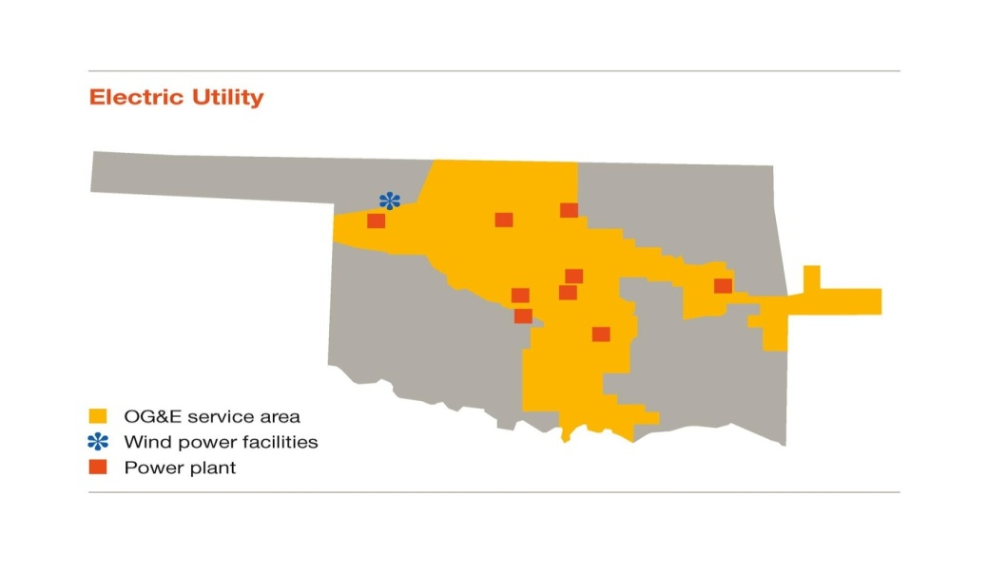
OG&E
782k retail customers
Total production: 6.7 GW
30k square miles
23k miles of overhead distribution & 10k miles of underground
500 substations & <1,000 distribution circuits
Notes:
Fix map dimensions.
Enlarged text

Slide 4
2010-11 DR Study
Hypothesis to Achieve DR Goals:
176 MW reduction from DR
2020 Capacity Needs
1.3 kW Average Reduction per Account
2020 Capacity Needs with DR
20% Enrollment
Notes:
Reduce peak demand to the extent that OG&E will avoid building a new 165 MW peaking unit in 2015 and a second 165 MW peaking unit in 2016
(Deleted all animations)

Slide 5
Smart Grid Demand Response Overview
Timeline
Quail Creek
2010 Study
3,000 Customers
2011 Study
Dynamic Segmentation
Deploy
Implement Dynamic Segmentation
New Pricing Products
Product
25 Customers
Acceptance
Energy Awareness
Reduced Peak
Acceptance
Technology
Dynamic Pricing
Commercial Results
Critical Price Results
Penetration Testing
6,000 Customers
~40 K Customers
Value-Added Products + Services
20% customer participation by Dec. 2014
70 MW
210 MW
Segment Results
Notes:
DID NOT TEST
Sustainability
Penetration

Slide 6
2010 Study Results Validate Hypothesis
kW Savings, VPP-CP High Weekday
 | Max | System Peak
Web | 0.51 | 0.45
IHD | 0.47 | 0.40
PCT | 1.96 | 1.21
Notes:
VPP rate on high price days we achieve max reduction at 1.96
Briefly identify the differences with devices
Max vs. system peak, the need for new rates
However, you can see we measured based on the max reduction we could achieve between 2- 7 but we need it between 4 and 5.
All-48%
Web-15%
Pct-58%
Ihd – 13%

Slide 7
2010 Results
Notes:
Explain axes
IHD and Web Follow Control Group: Compared to control group we did achieve significant reduction with IHD and Web.
Things to notice: dramatic drop with PCT and All 3 (blue and purple) around 3pm, spike after 7pm. Smaller but consistent demand response with web and IHD technologies.
VPP-CP High Weekday Usage

Slide 8
Study Design—Price Plans
VPP
Residential
Commercial
4.5¢/kWh
Off-Peak/Low
5.0¢/kWh
11.3¢/kWh
Standard
10¢/kWh
23¢/kWh
Medium
30¢/kWh
46¢/kWh
High/Critical
60¢/kWh
Notes:
This year’s strategy assessment looked at a variety of issues that OG&E and our industry is facing
We wrote white papers surrounding these subjects and subsets of these subjects
We formed cross-functional teams to read, review and study these issues
Last year, we had presented these as the driving forces that impact the business. We’ve looked at all of these. Last year, we stated we were going to focus on the technology. For example, in particular we know that technology is going to impact the business and we took a deeper dive into what does that mean and how we would implement which will be presented later on in Mike Gier, Mike Ballard and Sarah Staton’s presentation.
We’ve spent time this year evaluating these forces and their impact on the business. The focus of my presentation is to provide an update on the landscape.

Slide 9
VPP Demonstrates Price Elasticity
 | Maximum Demand Reduction PCT
 | Baseline | Reduction | Percent
TOU | 2.64 | 1.25 | 47%
VPP Low | 2.35 | 0.41 | 18%
VPP Standard | 2.45 | 1.11 | 45%
VPP Medium | 3.08 | 1.68 | 55%
VPP High | 3.37 | 1.96 | 58%
Notes:
VPP vs. TOU
TOU customers use less energy everyday.
All Customers.

Slide 10
VPP Demonstrates Price Elasticity
DR
Rev
Notes:
Revenue and DR
TOU
Low Price: Revenue lost and customer inconvenience
High Price: Not enough demand reduction

Slide 11
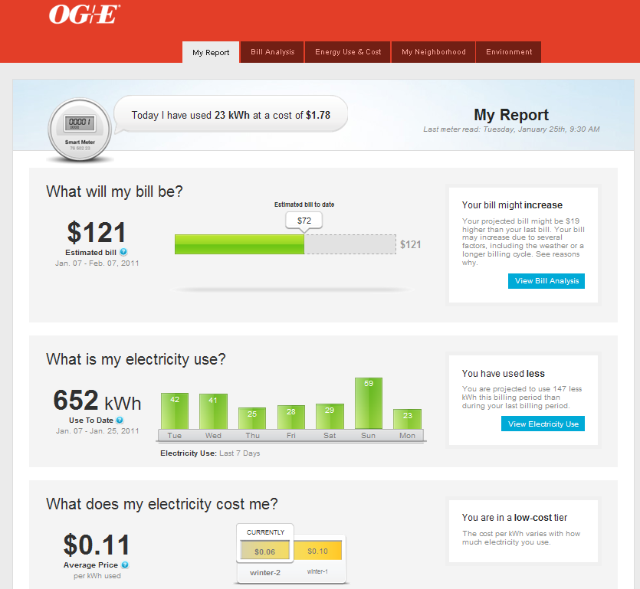
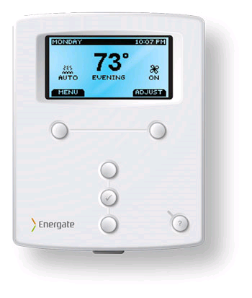
DR 2012
Web Portal
PCT
VPP Rate
Off-Peak 4.5¢/kWh
Standard 11.3¢/kWh
Medium 23¢/kWh
High/critical 46¢/kWh
Demand Response Program
Notes:
IHD is a potential future product for energy efficiency
PCT provides greatest demand reduction during peak periods.
Automatic price response
Reliable hardware
Durable good
Variable Peak Pricing drives load shifting
Price matched with cost to serve
Requires high degree of customer education
Unknown sustainability
Encourages customer engagement
myOGEpower
Gateway product (relationship changer)
Rate comparisons with “what-if” scenarios

Slide 12

Customer Engagement
Positive Energy Together
Partnership
Full Disclosure
Humility
Notes:
How this works with finaces… Before we get into finances, let’s look at the High-Level Summary

Slide 13
Customer Engagement - Guiding Principles
Pricing (rates) will reflect
true cost
minimizing any subsidies
within or across customer rate classes.
DR results will be obtained
through customer empowerment.
OG&E will not utilize any
direct control of
customer equipment
or appliances.
Customers will be provided
time-differentiated pricing
and be allowed to choose
their balance
of cost versus comfort.
Notes:
(Altered animations)

Slide 14



“Vendors Sell Hotdogs”… but ‘Partners’….
  Strategy: Tight collaboration
  Silver Spring Networks (SSN)
    Networks, management services
  Corix Utilities
    HVAC installers
    24/7 Emergency Service Statewide
  Energate
    In-home technology (Smart Thermostats)
      engaging consumers
      connecting to OGE network
      price signals
Notes:
Partner / Vendor RFI Summary (
May get a lot of questions on “how”

Slide 15
appendix

Slide 16
PCT Drives Load Shifting
 | On-Peak kWh | Off-Peak kWh
Segment 1
IHD Only | -13.2% | -3.3%
PCT Only | -34.8% | 9.0%
Segment 2
IHD Only | -13.3% | 2.1%
PCT Only | -22.4% | 23.1%
Segment 3
IHD Only | -6.0% | 5.7%
PCT Only | -46.6% | -5.7%
Notes:
DELETE (?)
Highlight IHDs, then PCTs
What are units?
Delete overall
Copy of Slide including Off-Peak Consumption
Much greater on peak reduction with a PCT than a IHD
PCT drives shifting, ~$317 per kW
IHD drives conserving = revenue erosion, ~$730 per kW
PCT and IHD cost about the same, but results are significantly different.

Slide 17
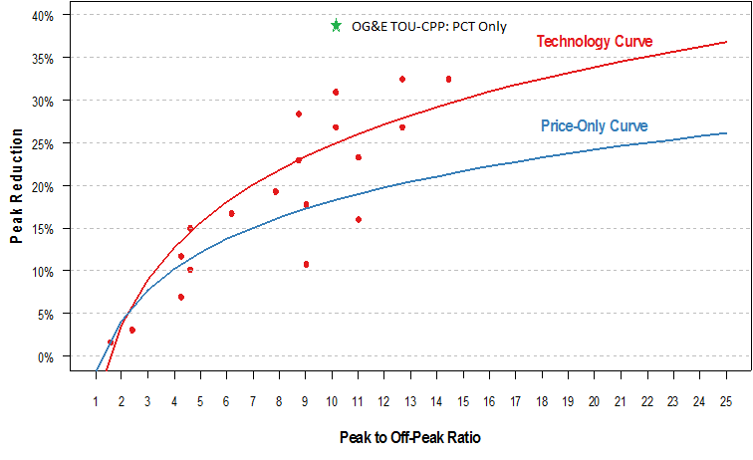
Dynamic Pricing Pilot Results by On-Peak to Off-Peak Ratio Results, with and without Enabling Technology

Slide 18
Summary: Rate & Technology Combinations
Rate/Technology | Baseline kWh Usage | kWh Savings | % Savings | Average kW Reduction | Peak kW Reduction
TOU-CP Non-Event Weekend
PCT Only | 16.76 | 0.28 | 1.67% | 0.06 | 0.10
IHD Only | 16.76 | 1.37 | 8.17% | 0.27 | 0.35
All | 16.76 | 0.57 | 3.43% | 0.11 | 0.16
Web Only | 16.76 | 0.44 | 2.63% | 0.09 | 0.16
TOU-CP Non-Event Weekday
PCT Only | 14.85 | 4.43 | 29.87% | 0.89 | 1.26
IHD Only | 14.85 | 2.45 | 16.47% | 0.49 | 0.52
All | 14.85 | 3.89 | 26.21% | 0.78 | 1.11
Web Only | 14.85 | 1.61 | 10.86% | 0.32 | 0.35
VPP-CP Low Weekend
PCT Only | 16.76 | -0.12 | -0.71% | -0.02 | 0.06
IHD Only | 16.76 | 0.35 | 2.11% | 0.07 | 0.14
All | 16.76 | 0.27 | 1.60% | 0.05 | 0.09
Web Only | 16.76 | 0.62 | 3.67% | 0.12 | 0.19
VPP-CP Low Weekday
PCT Only | 11.60 | 1.28 | 11.07% | 0.26 | 0.34
IHD Only | 11.60 | 1.29 | 11.13% | 0.26 | 0.29
All | 11.60 | 1.43 | 12.36% | 0.29 | 0.34
Web Only | 11.60 | 1.52 | 13.07% | 0.30 | 0.33
Notes:
Move to appendix

Slide 19
Summary: Rate & Technology Combinations
Rate/Technology | Baseline kWh Usage | kWh Savings | % Savings | Average kW Reduction | Peak kW Reduction
VPP-CP Standard
PCT Only | 14.09 | 3.08 | 21.85% | 0.62 | 1.07
IHD Only | 14.09 | 0.89 | 6.28% | 0.18 | 0.19
All | 14.09 | 2.84 | 20.18% | 0.57 | 0.93
Web Only | 14.09 | 1.07 | 7.59% | 0.21 | 0.25
VPP-CP Medium
PCT Only | 17.13 | 5.01 | 29.24% | 1.00 | 1.64
IHD Only | 17.13 | 1.38 | 8.04% | 0.28 | 0.29
All | 17.13 | 4.39 | 25.63% | 0.88 | 1.38
Web Only | 17.13 | 1.41 | 8.26% | 0.28 | 0.32
VPP-CP High
PCT Only | 18.37 | 5.98 | 32.55% | 1.20 | 1.92
IHD Only | 18.37 | 1.96 | 10.65% | 0.39 | 0.45
All | 18.37 | 5.20 | 28.29% | 1.04 | 1.63
Web Only | 18.37 | 2.16 | 11.76% | 0.43 | 0.51
Notes:
Move to appendix

Slide 20
Peak Savings by Income: VPP-CP High
Income Group | Baseline kWh Usage | kWh Savings | % Savings | Average kW Reduction | Peak kW Reduction
Low
PCT Only | 14.85 | 7.10 | 47.84% | 1.42 | 1.95
IHD Only | 14.85 | 0.75 | 5.07% | 0.15 | 0.20
All | 14.85 | 2.96 | 19.93% | 0.59 | 1.14
Web Only | 14.85 | 1.88 | 12.65% | 0.38 | 0.53
Middle
PCT Only | 16.88 | 3.48 | 20.63% | 0.70 | 1.65
IHD Only | 16.88 | 2.33 | 13.82% | 0.47 | 0.57
All | 16.88 | 5.06 | 29.99% | 1.01 | 1.61
Web Only | 16.88 | 1.63 | 9.68% | 0.33 | 0.38
High
PCT Only | 21.87 | 7.14 | 32.63% | 1.43 | 2.15
IHD Only | 21.87 | 3.02 | 13.83% | 0.60 | 0.63
All | 21.87 | 8.02 | 36.67% | 1.60 | 2.24
Web Only | 21.87 | 3.03 | 13.84% | 0.61 | 0.69

Slide 21
On Peak Savings by Age: VPP-CP High
Age Group | Baseline kWh Usage | kWh Savings | % Savings | Average kW Reduction | Peak kW Reduction
Young
PCT Only | 15.18 | 4.38 | 28.85% | 0.88 | 1.51
IHD Only | 15.18 | 2.33 | 15.33% | 0.47 | 0.52
All | 15.18 | 5.46 | 35.97% | 1.09 | 1.46
Web Only | 15.18 | 2.29 | 15.10% | 0.46 | 0.53
Family
PCT Only | 20.66 | 6.54 | 31.63% | 1.31 | 2.36
IHD Only | 20.66 | 3.15 | 15.27% | 0.63 | 0.70
All | 20.66 | 5.02 | 24.31% | 1.00 | 1.81
Web Only | 20.66 | 3.80 | 18.37% | 0.76 | 0.84
Mature
PCT Only | 18.06 | 7.20 | 39.87% | 1.44 | 2.02
IHD Only | 18.06 | 0.72 | 3.99% | 0.14 | 0.21
All | 18.06 | 5.06 | 28.01% | 1.01 | 1.68
Web Only | 18.06 | 0.85 | 4.71% | 0.17 | 0.31

